Slide 1

Chapter 5
Atmospheric pressure and Wind

Slide 2
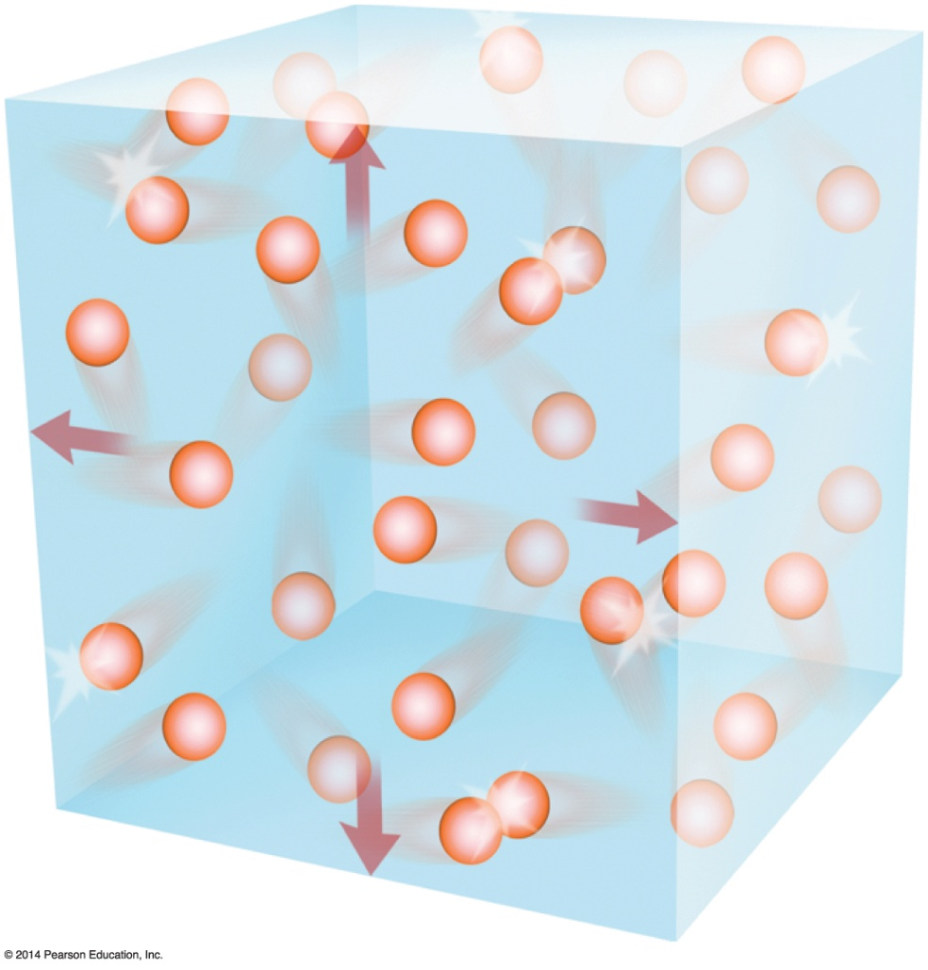

The Nature of Atmospheric Pressure
Gas molecules are continuously in motion.
Force exerted by gas molecules is called atmospheric pressure.
Force is exerted on every surface the gas touches.
Pressure is approximately 14 pounds per square inch.

Slide 3
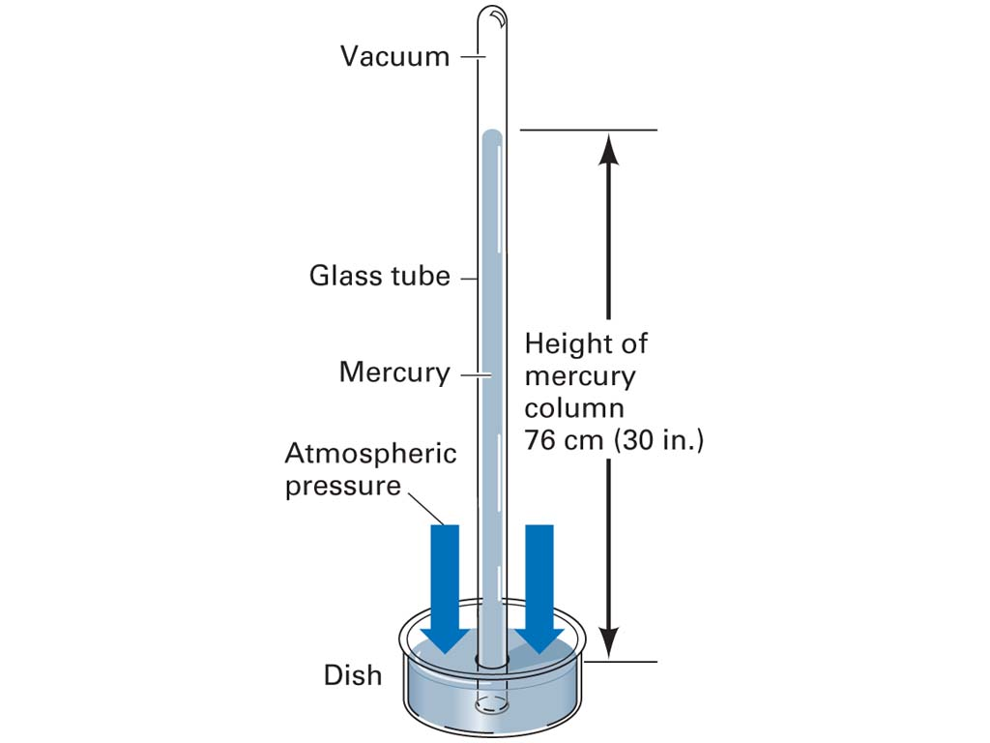

Atmospheric Pressure
Atmospheric pressure: pressure exerted by the atmosphere because of the force of gravity acting upon the overlying column of air
Barometer: instrument that measures atmospheric pressure
Notes:
Measured with a barometer
Average pressure at sea level can be expressed in different ways:
1 kilogram/cm²=15 pounds/in²= 101,320 Pa (pascals)=76 cm Hg (mercury)=29.92 in Hg=1013.2 mb (millibars)

Slide 4
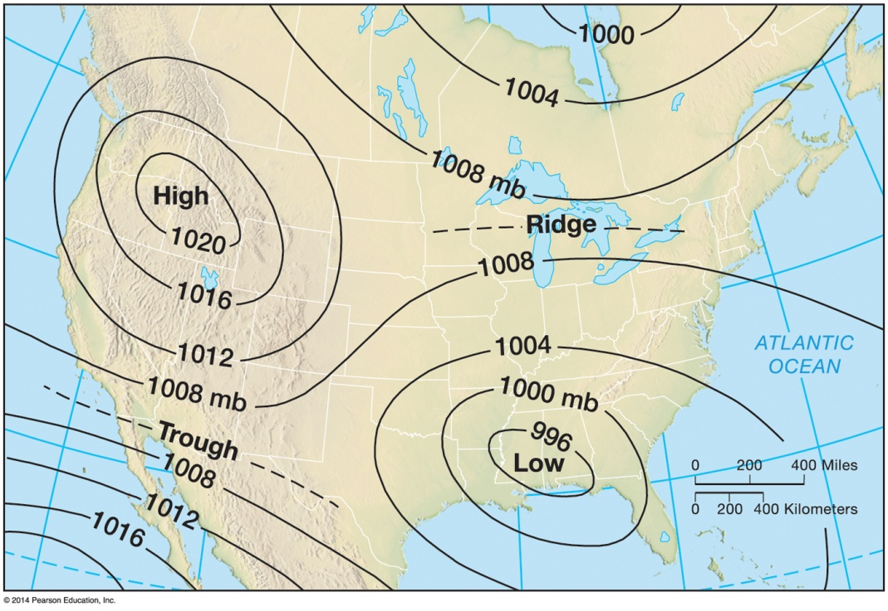

The Nature of Pressure
Isobars

Slide 5
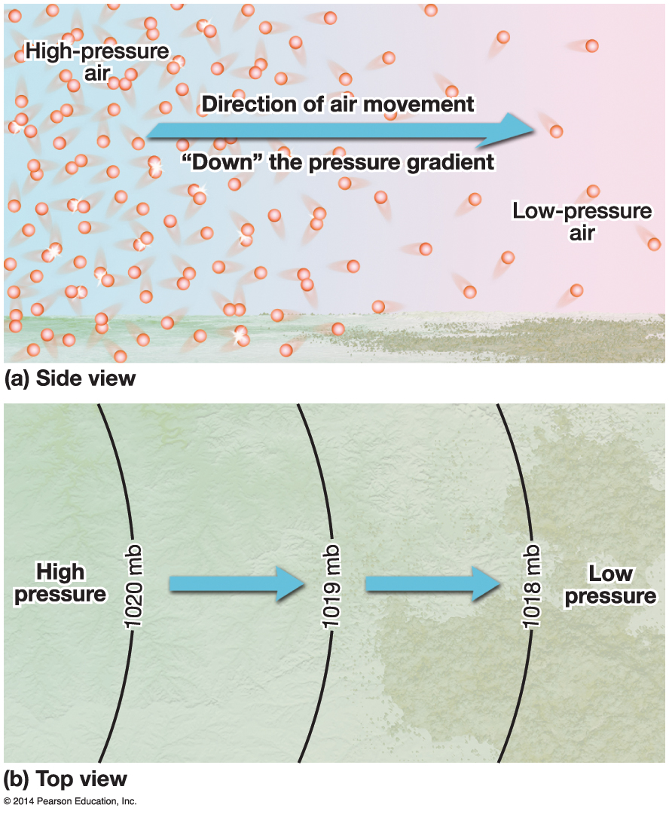
The Nature of Wind
Origination of wind
Uneven heating of Earth’s surface creates temperature and pressure gradients
Direction of wind results from pressure gradient
Winds blow from high pressure to low pressure

Slide 6
The Nature of Wind
Forces that govern the wind
Pressure gradient force
Coriolis force
Turns wind to the right in the Northern Hemisphere; left in Southern Hemisphere
Only affects wind direction, not speed; though faster winds turn more
Friction
Wind is slowed by Earth’s surface due to friction; does not affect upper levels

Slide 7
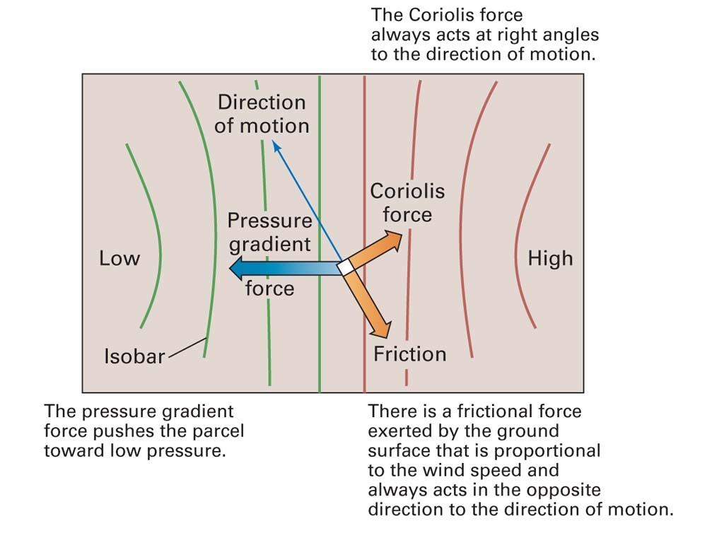
Cyclones and Anticyclones
Pressure Gradient
Coriolis Effect
Friction
Notes:
SURFACE AIR
CORIOLIS FORCE PULLS WIND TO RIGHT SO DIRECTION OF MOTION PULLED TO RIGHT.

Slide 8
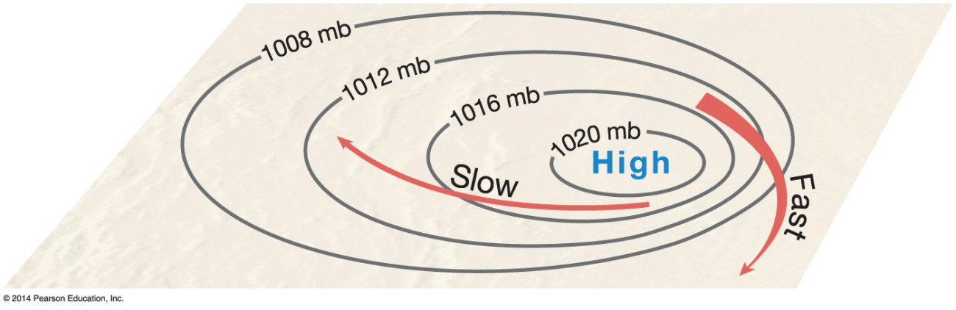
The Nature of Wind
Wind speed
Tight pressure gradients (isobars close together) indicate faster wind speeds

Slide 9
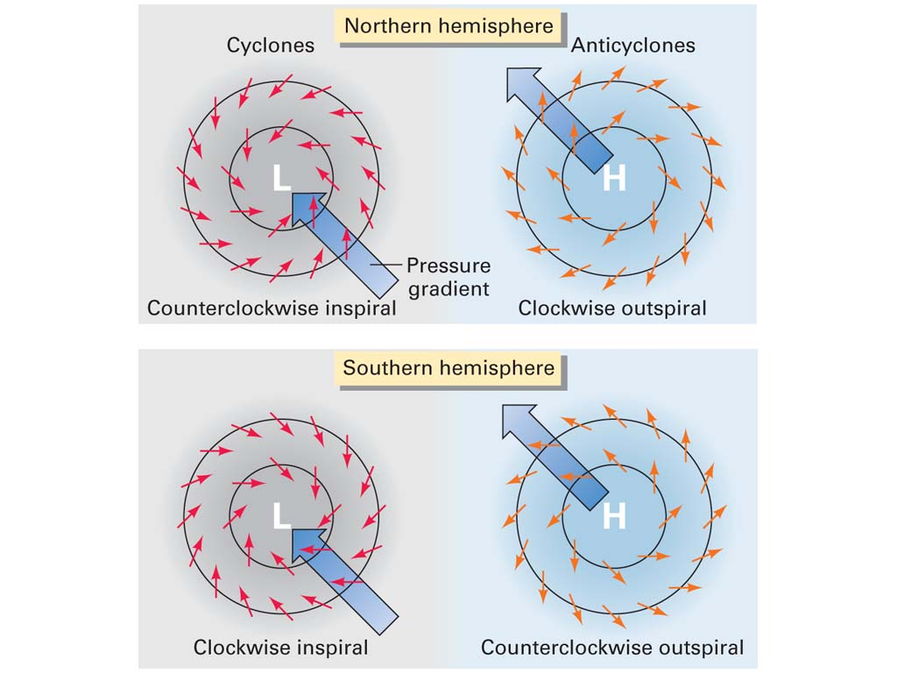
Cyclones and Anticyclones
Cyclone: center of low atmospheric pressure
Air spirals inward (convergence) and upward
Associated with cloudy, rainy weather
Anticyclone: center of high atmospheric pressure
Air spirals downward and outward (divergence)
Associated with fair weather

Slide 10
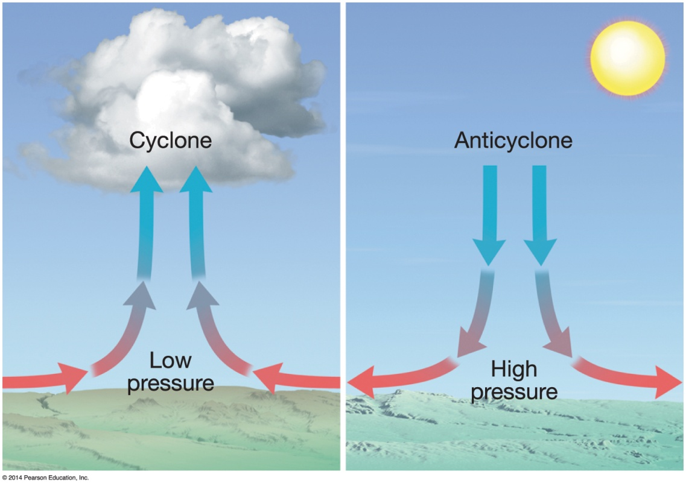
Vertical motions
Convergence
Divergence

Slide 11
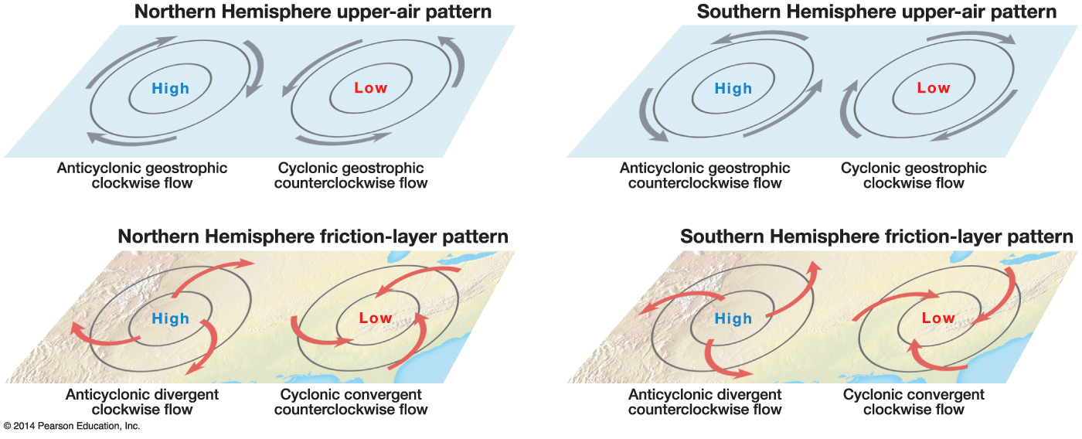
Cyclones and Anticyclones
Wind directions around cyclones and anticyclones dictated by force balances described previously
Differing Coriolis force causes winds to blow opposite in each hemisphere

Slide 12
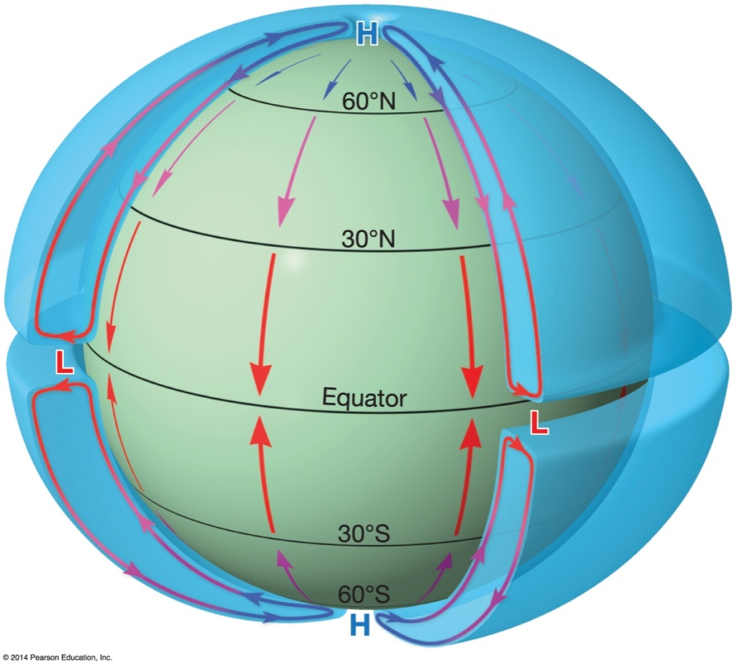
The General Circulation of the Atmosphere
Non rotating earth
Thermal low pressure forms over equator
Thermal high forms over poles

Slide 13
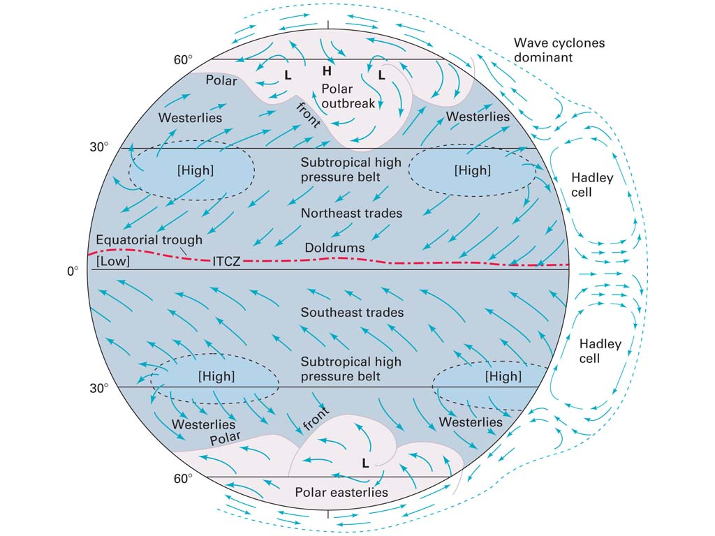
Global Wind and Pressure Patterns

Slide 14
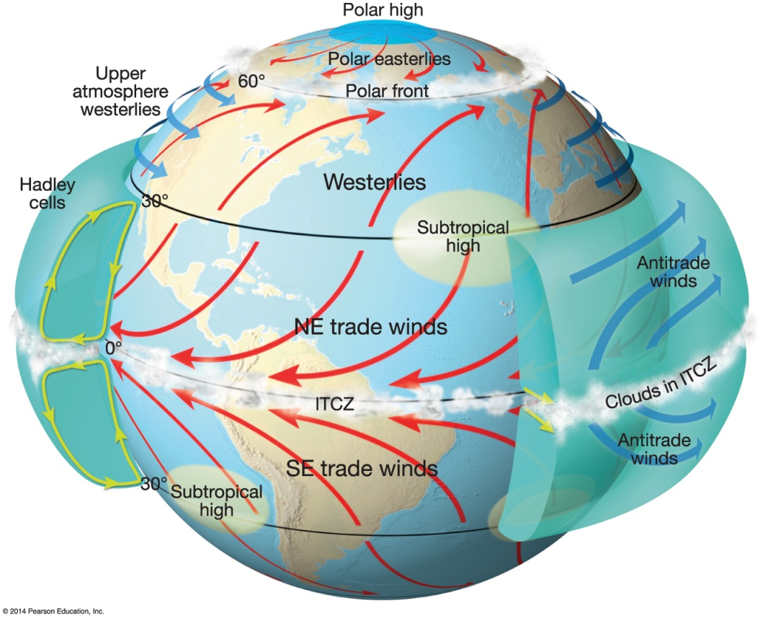
The General Circulation of the Atmosphere
Observed general circulation
Addition of Earth’s rotation increases complexity of circulation
Hadley cells

Slide 15
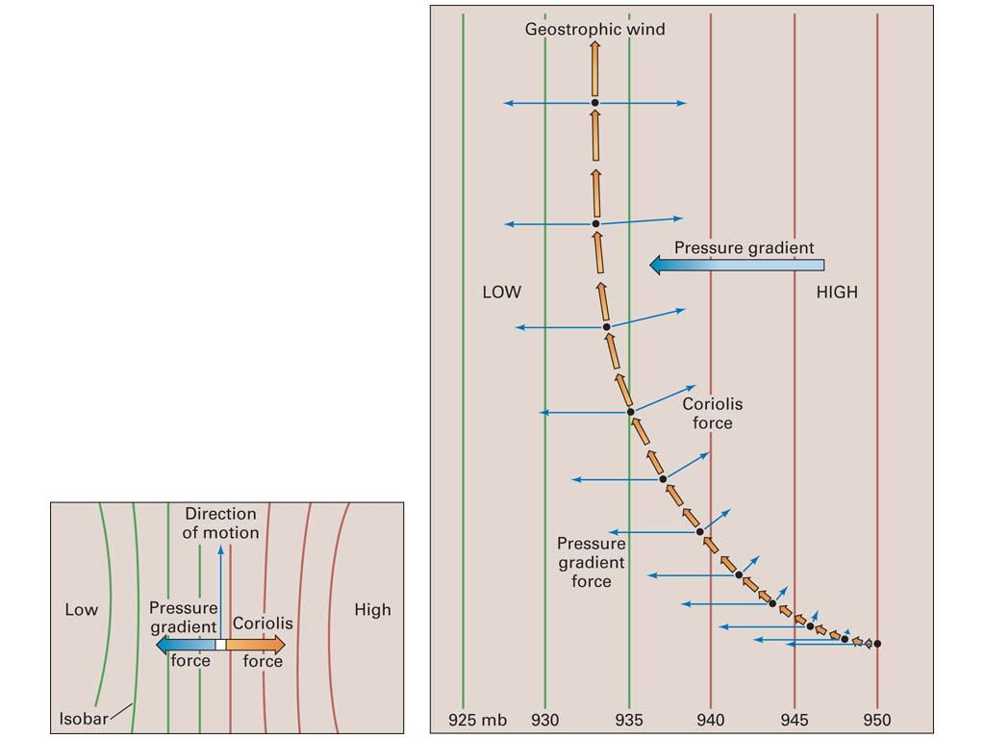
Winds Aloft
The Geostrophic Wind
Forces acting on an upper air parcel:
1. Pressure gradient force:
2. Coriolis force
Geostrophic Wind: wind at high levels above the Earth’s surface blowing parallel with a system of straight parallel isobars
Notes:
HIGHER UP IN ALTITUDE
No Frictional force with winds aloft.

Slide 16
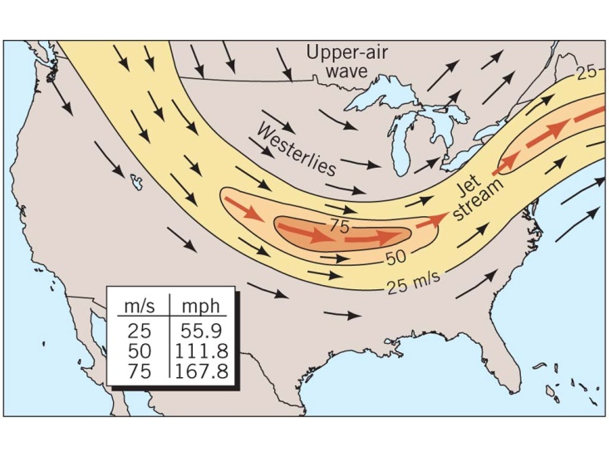
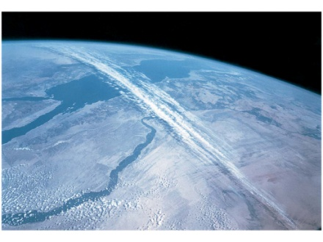
Winds Aloft
Jet streams: high-speed air flow in narrow bands within the upper-air westerlies and along certain other global latitude zones at high levels

Slide 17
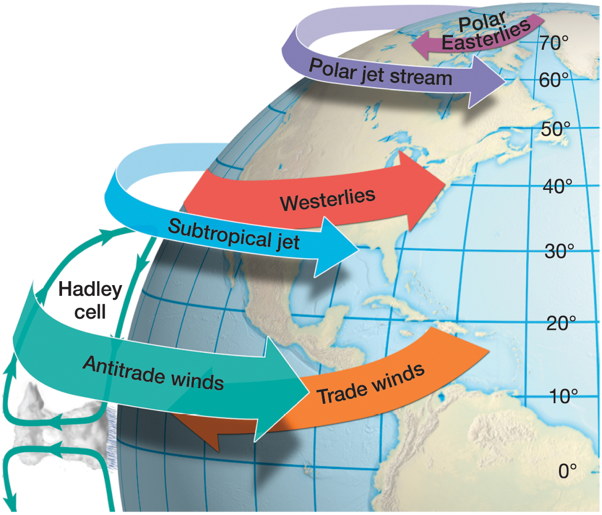
Notes:
Chapter 5, Figure 5.28 Labeled

Slide 18
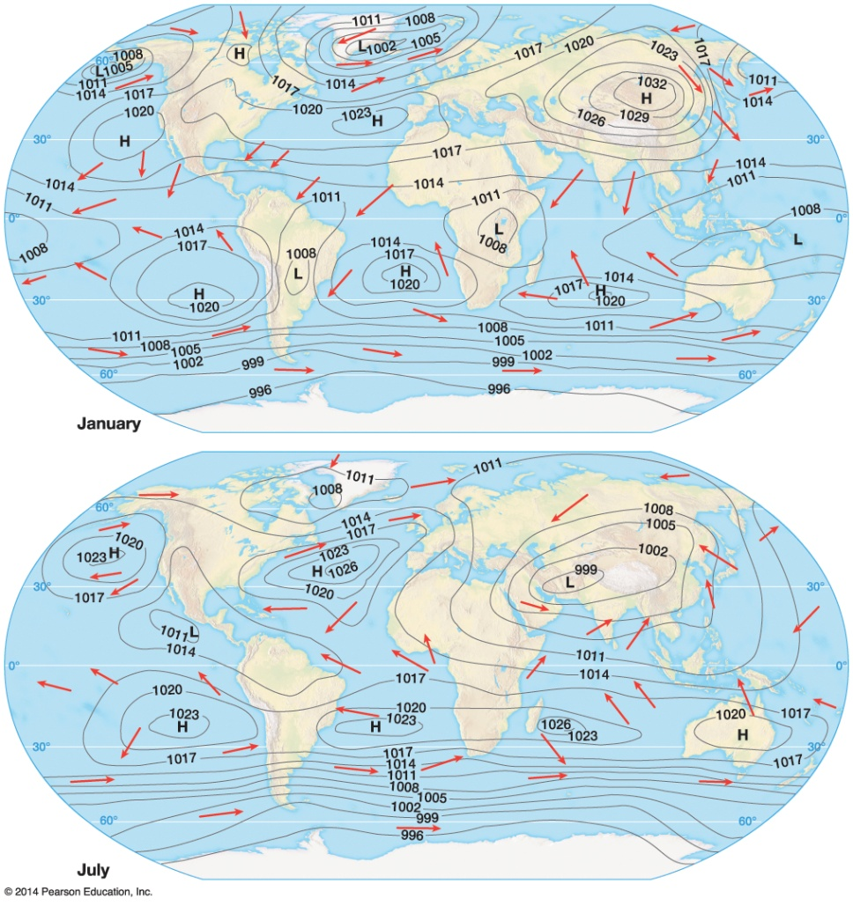
The General Circulation of the Atmosphere
Seasonal differences in the general circulation

Slide 19
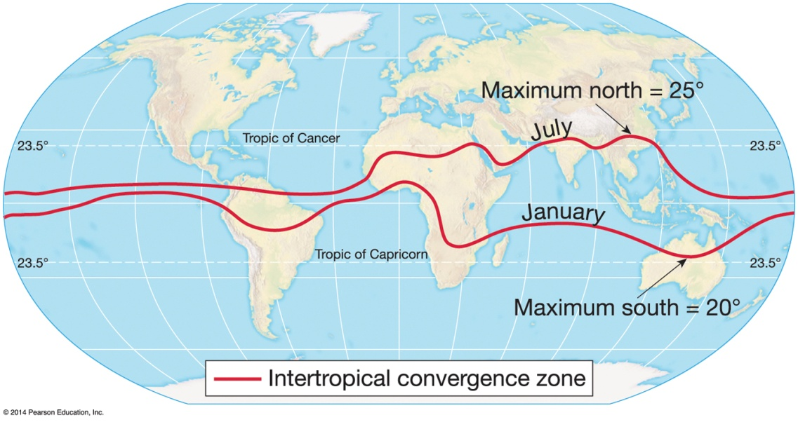
Modifications to the General Circulation
Seasonal modifications
Seven general circulation components shift seasonally.
Components shift northward during Northern Hemisphere summer.
Components shift southward during Southern Hemisphere summer.

Slide 20
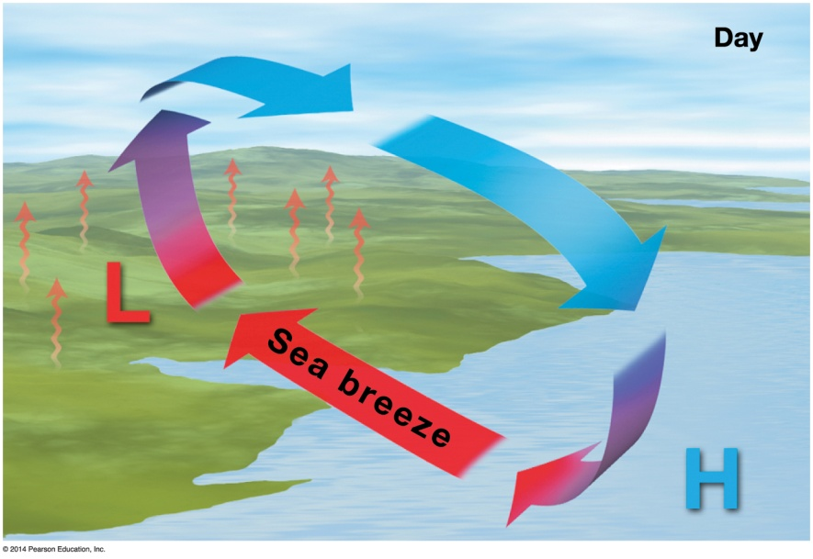
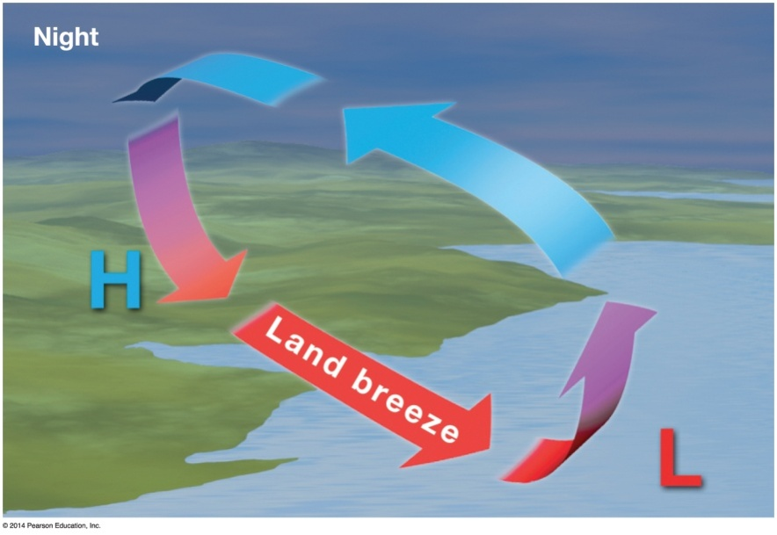
Localized Wind Systems
Sea breezes
Water heats more slowly than land during the day
Thermal low over land; thermal high over sea
Wind blows from sea to land
Land breezes
At night, land cools faster
Thermal high over land; thermal low over sea
Wind blows from land to sea

Slide 21
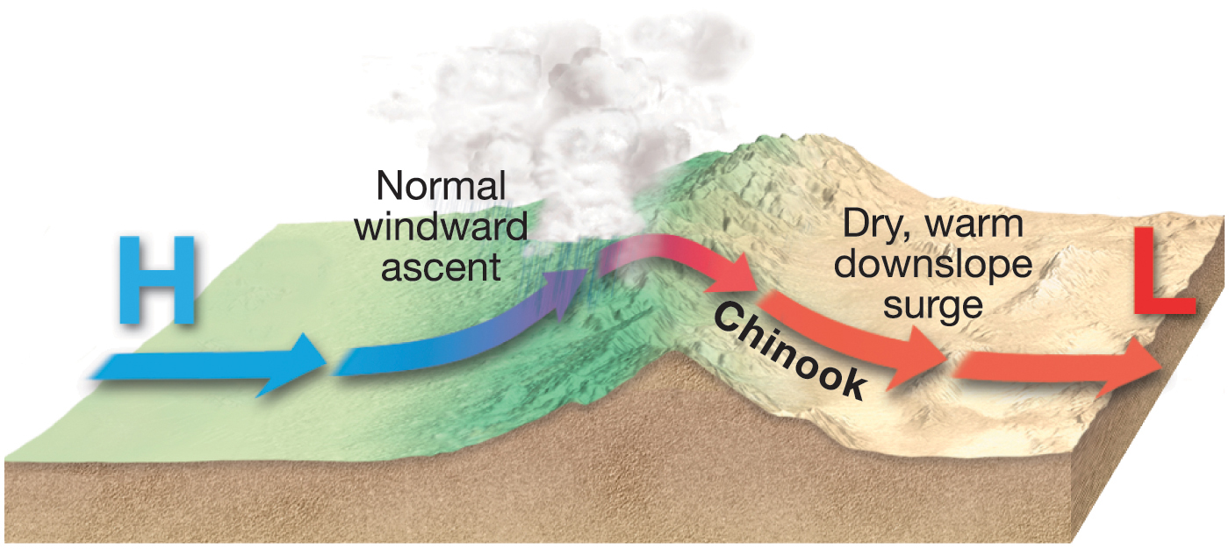
Notes:
Chapter 5, Figure 5.36 Labeled

Slide 22
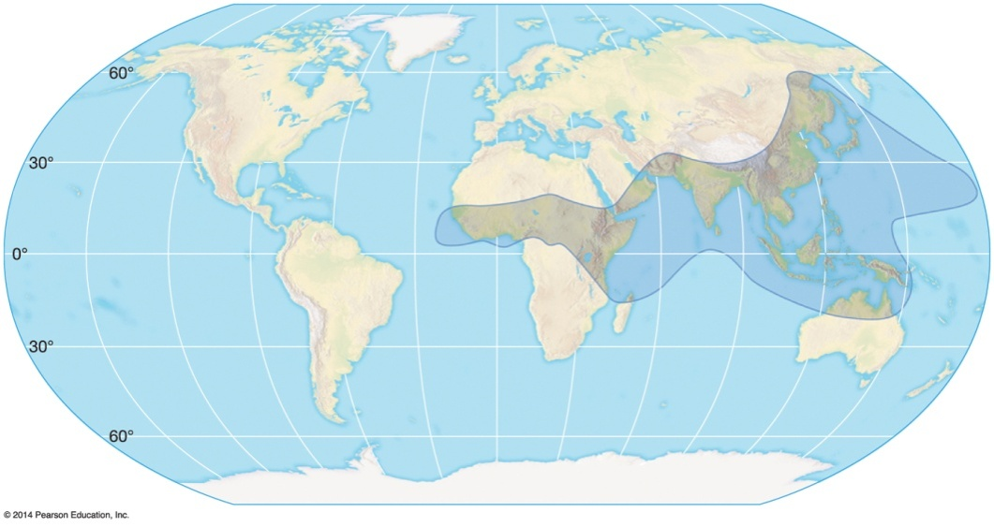
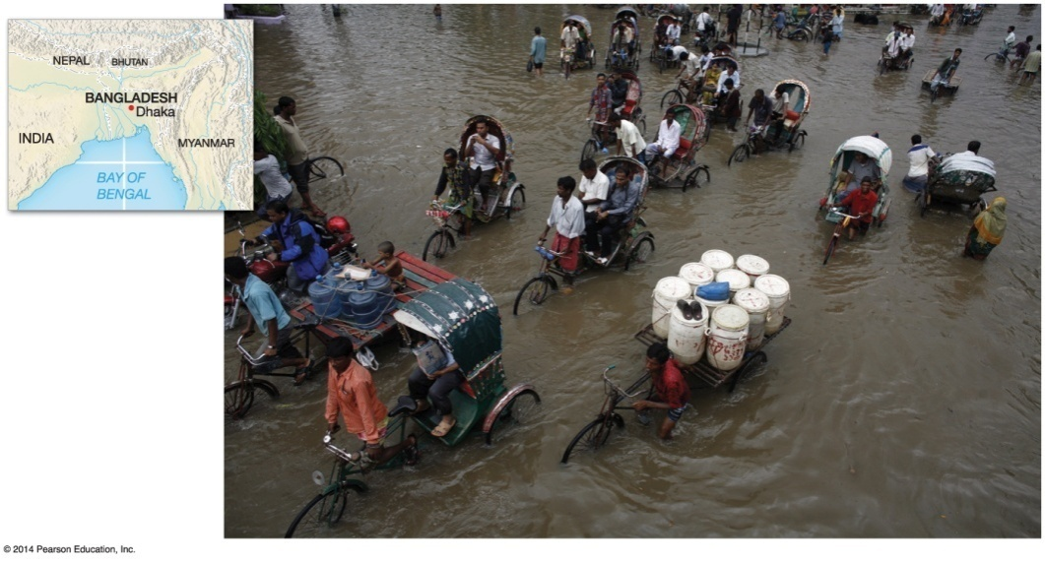
Modifications to the General Circulation
Monsoons
Winds onshore during summer
Winds offshore during winter
Develop due to shifts in positions of ITCZ and unequal heating of land and water

Slide 23
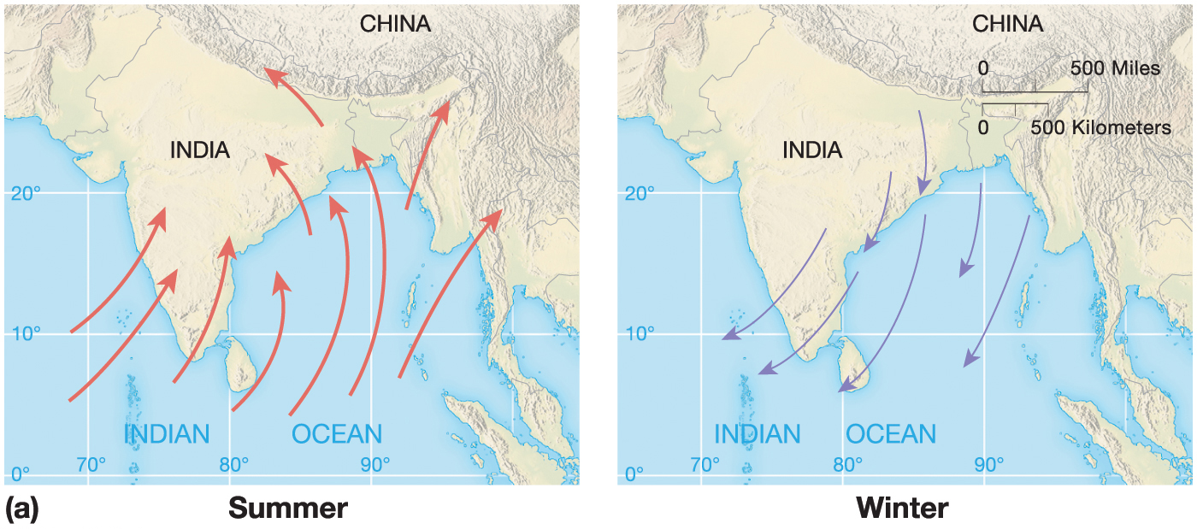
Notes:
Chapter 5, Figure 5.32A Labeled

Slide 24
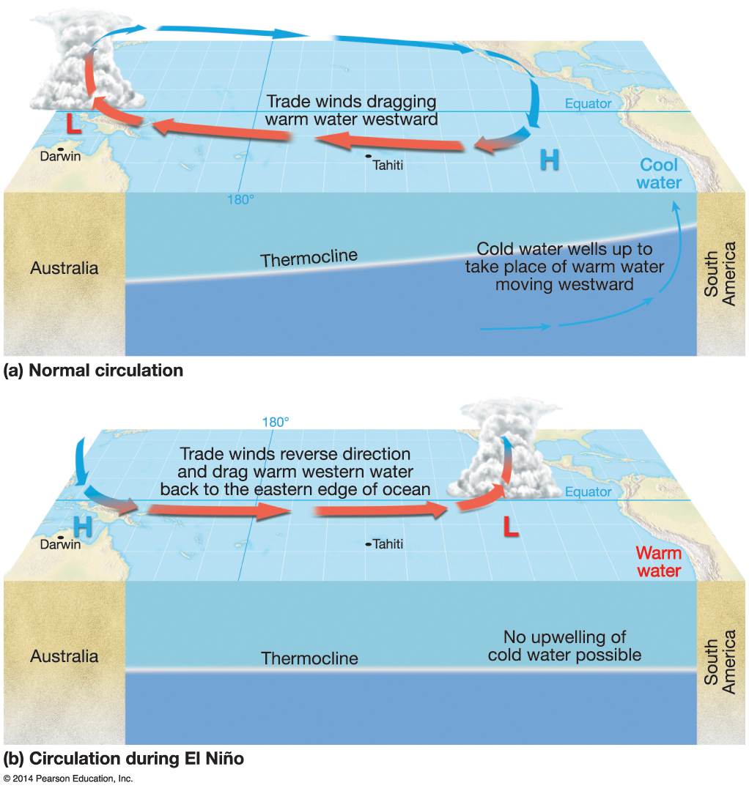
El Niño-Southern Oscillation
Circulation patterns – Walker circulation (see figure)

